Slide 1
Human Computer
Interaction
Module 1
HCI Foundation s
Dr. J.Prassanna,
VIT Chennai

Slide 2
Outline
Introduction, Input–output channels, Human memory Thinking: reasoning and problem solving.
Emotion, Individual differences, Psychology and the design of interactive systems, Text entry devices, Positioning, pointing and drawing.
Display devices, Devices for virtual reality and 3D interaction.

Slide 3
Introduction
What is Human-computer interaction ?
  Human-computer interaction (HCI) researches the design and use of computer technology, focused on the interfaces between people (users) and computers.
    studies the design and use of computer technology, focused on the interfaces between people (users) and computers. [Wikipedia]

Slide 4
Introduction
What happens when a human and a computer system interact to perform a task?
  task - write document, explore the web, solve mathematic problem, search for knowledge , drive home, book movie tickets, do banking, ...
Why is this important?
Computer systems affect every person
Safety, satisfaction, utility is critical
Product success depends on ease of use

Slide 5
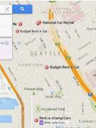
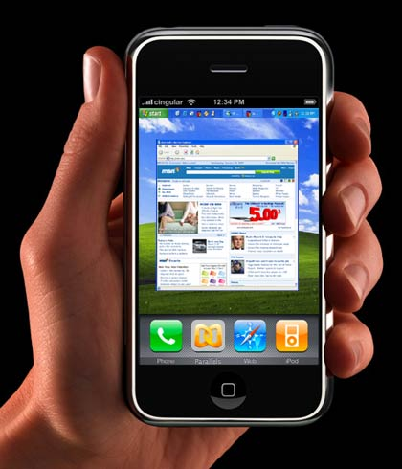
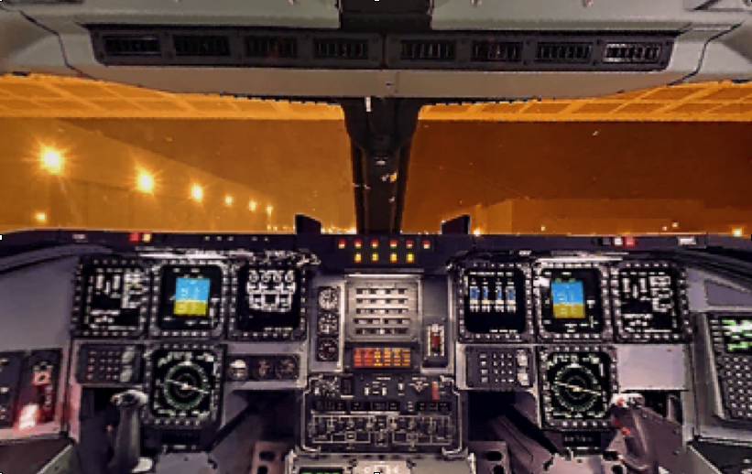
Interfaces in the Real World
Not just computers!
  Media player
  Wristwatch
  Phone
  Copier
  Car
  Plane cockpit
  Airline reservation
  Air traffic control

Slide 6
Introduction
    User
        By "user", we may mean an individual user, a group of users working together. An appreciation of the way people's sensory systems (sight, hearing, touch) relay information is vital.

Slide 7
Introduction
Computer
      When we talk about the computer, we're referring to any technology ranging from desktop computers, to large scale computer systems.
Interaction
      By interaction we mean any communication between a user and computer, be it direct or indirect.
          Direct interaction - involves a dialog with feedback and control throughout performance of the task.
          Indirect interaction - involves batch processing or intelligent sensors controlling the environment

Slide 8
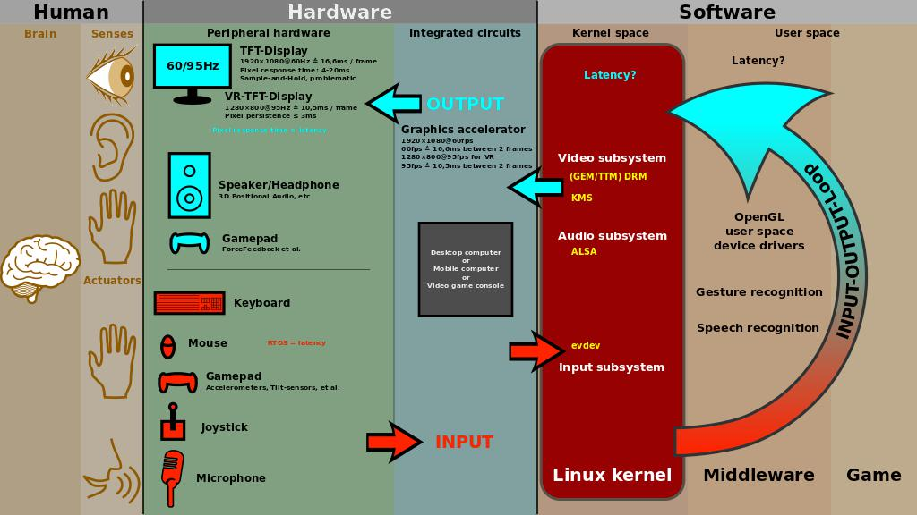
Contd..,
Source:https://images.app.goo.gl/ENiJDuQuu24GJBjv9

Slide 9
Introduction
The Goals of HCI
Usability
Factors in HCI
Organization Factors
The User
User Interface
Disciplines contributing to HCI

Slide 10
Input–output channels
A person‘s interaction with the outside world occurs through information being received and sent: input and output.
In an interaction with a computer the user receives information that is output by the computer, and responds by providing input to the computer the user‘s output becomes the computer‘s input and vice versa.
There are five major senses: sight, hearing, touch, taste and smell.

Slide 11

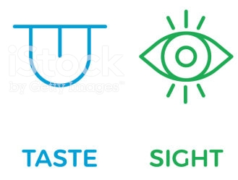
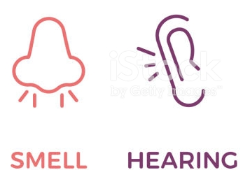
Input–output channels
There are five major senses: sight, hearing, touch, taste and smell.

Slide 12
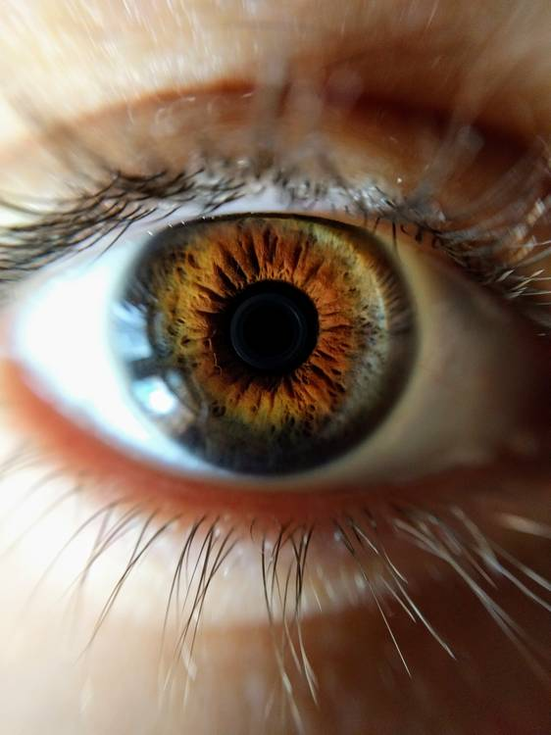
Input–output channels
Input Channel-Vision:
  The human eye
  Visual perception
Source:
A Dix, Janet Finlay, G D Abowd, R Beale., Human-Computer Interaction, 3rd Edition, Pearson Publishers,2008.

Slide 13
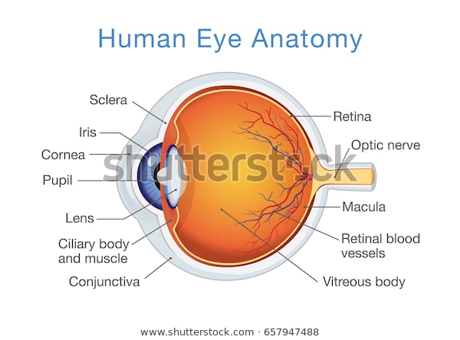
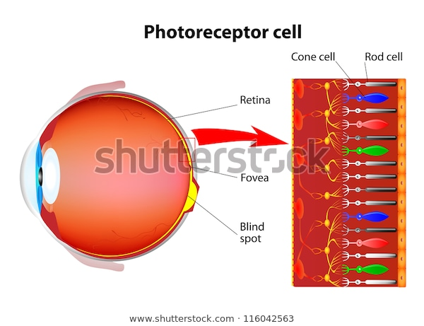
Input–output channels

Slide 14
Input–output channels
Input Channel-Vision:
  The human eye (important components)
      Rods
      Cones
      Fovea
      Blind Spot
      Nerve Cell
        X-Cells
        Y-Cells

Slide 15
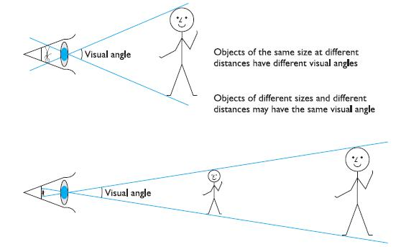
How does the eye perceive size, depth and relative distances?
Source:
1. A Dix, Janet Finlay, G D Abowd, R Beale., Human-Computer Interaction, 3rd Edition, Pearson Publishers, 2008.

Slide 16
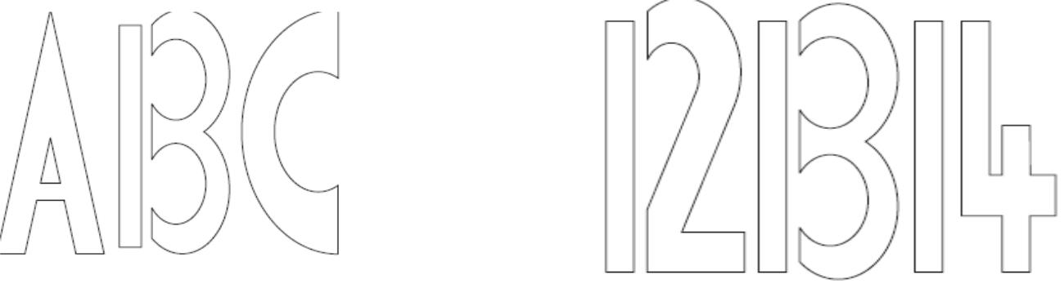
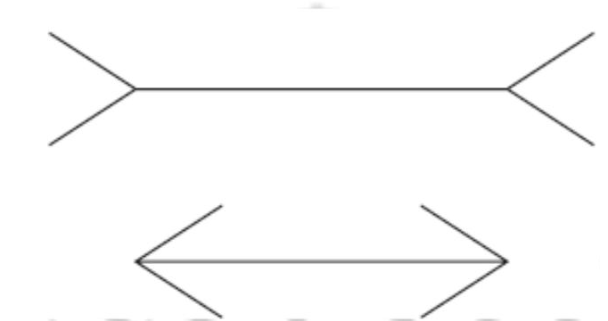
The capabilities and limitations of visual processing
Source:
A Dix, Janet Finlay, G D Abowd,
R Beale., Human-Computer Interaction,
3rd Edition, Pearson Publishers, 2008.

Slide 17
Other input–output channels
Hearing
  The sense of hearing is often considered secondary to sight.
Processing sound
  Processing sound has a number of characteristics which we can differentiate.
    Pitch, Loudness, Timbre and sound’s location
Touch
  Touch provides us with vital information about our environment. It tells us when we touch something hot or cold, and can therefore act as a warning.
Movement
  A simple action such as hitting a button in response to a question involves a number of processing stages.

Slide 18
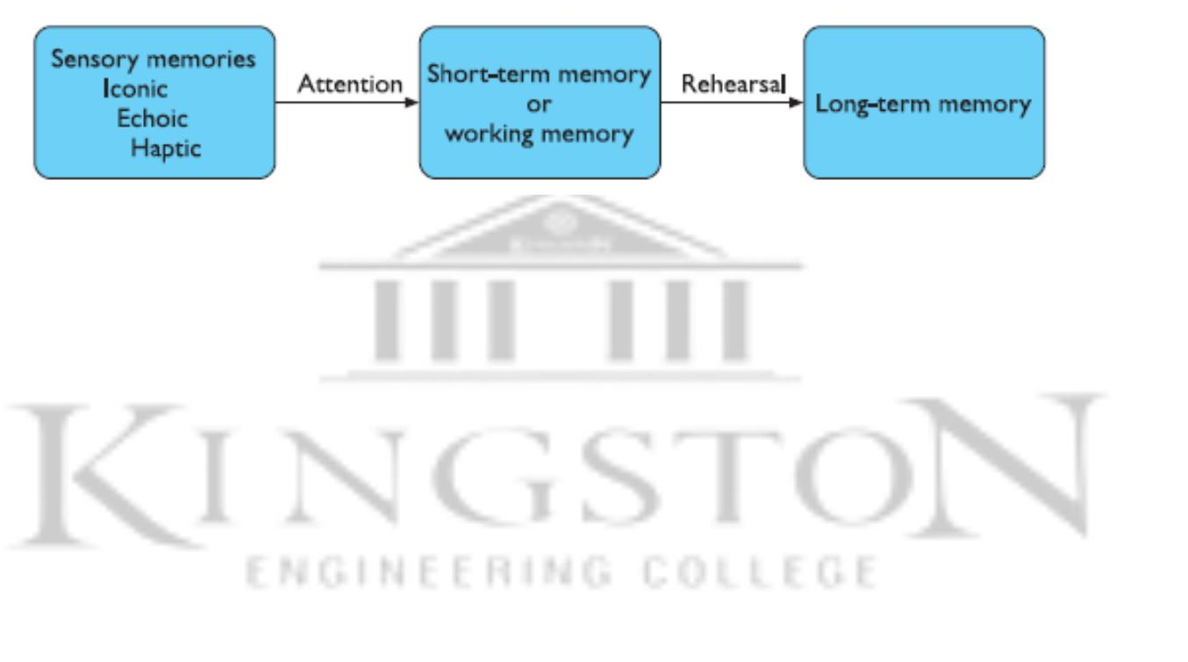
HUMAN MEMORY
Our memory contains our knowledge of actions or procedures.
A model of the structure of memory
Source: A Dix, Janet Finlay, G D Abowd, R Beale., Human-computer Interaction,
3rd Edition, Pearson Publishers, 2008.

Slide 19
Sensory memory
  The sensory memories act as buffers for stimuli received through the senses.
  A sensory memory exists for each sensory channel: iconic memory for visual stimuli, echoic memory (sound) for aural stimuli and haptic memory for touch.
  These memories are constantly overwritten by new information coming in on these channels.
  the average person can remember 7 ±2 digits

Slide 20
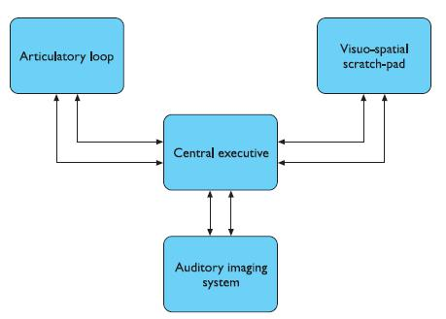
Short-term memory
Short-term memory or working memory acts as a scratch-pad‘ for temporary recall of information. It is used to store information which is only required quickly
Source: A Dix, Janet Finlay,
G D Abowd, R Beale., “Human-Computer
Interaction”, 3rd Edition, Pearson
Publishers, 2008.

Slide 21
Long-term memory
If short-term memory is our working memory or scratch-pad, long-term memory is our main resource. Here we store factual information, experiential knowledge, procedural rules of behavior – in fact, everything that we know.
There are two types of long-term memory: episodic memory and semantic memory.
  Episodic memory represents our memory of events and experiences in a serial form.
  Semantic memory, on the other hand, is a structured record of facts, concepts and skills that we have acquired. The information in semantic memory is derived from that in our episodic memory.

Slide 22
Long-term memory
Structure of Memory representation
  Semantic network
  Frames
  Scripts

Slide 23
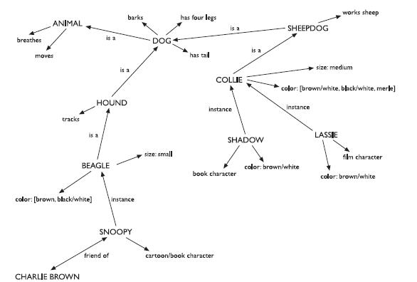
Structure of Memory representation
  Semantic network:
    -Items are associated to
    each other in classes
    and may inherit attributes
    from parent classes.
    This model is known as
    semantic network.
Source:
1. A Dix, Janet Finlay, G D Abowd, R Beale., Human-Computer Interaction, 3rd Edition, Pearson Publishers, 2008.

Slide 24
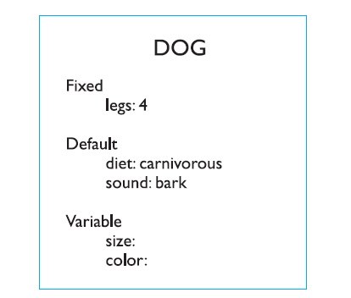
Structure of Memory representation
  Frames
  -Frames extend semantic networks
  to include structured hierarchical
  information.

Slide 25
Structure of Memory representation
Scripts- attempt to model the representation of stereotypical knowledge about situations.
Eg. Yesterday late night Sam came to the room. He is sleeping now I think he will not come for breakfast.
A script consists of no. of elements
1.Entry conditions - Conditions that must be satisfied for the script to be activated.
2.Result -Conditions that will be true after the script is terminated.
3.Props -Objects involved in the events described in the script.
4.Roles -Actions performed by particular participants.
5.Scenes- The sequences of events that occur.
6.Tracks -A variation on the general pattern representing an alternative scenario.

Slide 26
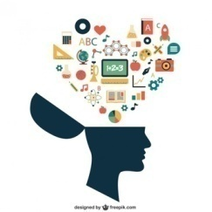
THINKING: REASONING AND PROBLEM SOLVING
Humans, on the other hand, are able to use information to reason and solve problems, and indeed do these activities when the information is partial or unavailable.
Thinking can require different amounts of knowledge. Some thinking activities are much directed and the knowledge required is constrained. Others require vast amounts of knowledge from different domains.

Slide 27
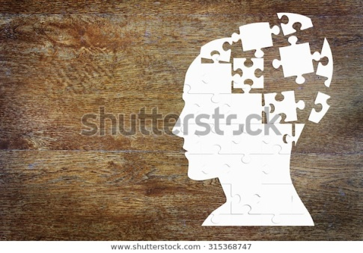
Reasoning
Reasoning is the process by which we use the knowledge we have to draw conclusions or infer something new about the domain of interest. There are a number of different
Types of reasoning:
  Deductive,
  Inductive
  Abductive

Slide 28
Reasoning
Deductive reasoning
  Deductive reasoning derives the logically necessary conclusion from the given premises.
  Like algebra a=b & b=c then a=c.
    For example,
        If it is Friday then she will go to work. It is Friday.
        Therefore she will go to work
        Red meat has iron in it, and beef is red meat. Therefore, beef has iron in it.

Slide 29
Reasoning
Inductive reasoning
    Induction is generalizing from cases we have seen to infer information about cases we have not seen. Induction is a useful process, which we use constantly in learning about our environment.

Slide 30
Reasoning
Abductive reasoning
  is when you take a set of observations and use a theory to explain them. This is very similar to how doctors work on patients by taking symptoms to make a diagnosis
  For example, suppose we know that Sam always drives too fast when she has been drinking.

Slide 31
Problem solving
Problem solving
  If reasoning is a means of inferring new information from what is already known, problem solving is the process of finding a solution to an unfamiliar task, using the knowledge we have.
  Human problem solving is characterized by the ability to adapt the information we have to deal with new situations often solutions seem to be original and creative. There are a number of different views of how people solve problems.

Slide 32
Problem solving
  Gestalt theory
    Problem solving is both productive and reproductive.
    Reproductive problem solving draws on previous experience as the behaviorists claimed, but productive problem solving involves insight and restructuring of the problem.

Slide 33
Problem solving
  Problem space theory (Newell and Simon proposed)
    The problem space comprises problem states, and problem solving involves generating these states using legal state transition operators. The problem has an initial state and a goal state and people use the operators to move from the former to the latter.
    Such problem spaces may be huge, and so heuristics are employed to select appropriate operators to reach the goal.
    Eg: Solving puzzles

Slide 34
Problem solving
  Means–ends analysis (heuristic)
    In means–ends analysis the initial state is compared with the goal state and an operator chosen to reduce the difference between the two.
  Analogy in problem solving
    A third element of problem solving is the use of analogy. Similarities between the known domain and the new one are noted and operators from the known domain are transferred to the new one.

Slide 35
Problem solving
  Skill acquisition
    Gradually acquire skill in a particular domain area. Eg: Chess Playing
    One model of skill acquisition is Anderson’s ACT* model (Adaptive Control of Thought) . ACT* identifies three basic levels of skill:
      1. The learner uses general-purpose rules which interpret facts about a problem. This is slow and demanding on memory access.
      2. The learner develops rules specific to the task.
      3. The rules are tuned to speed up performance.

Slide 36
Problem solving
  Errors and mental models
    Error:
      If a pattern of behavior has become automatic and we change some aspect of it, the more familiar pattern may break through and cause an error. Other errors result from an incorrect understanding, or model, of a situation or system.
      People build their own theories to understand the causal behaviour of systems. These have been termed mental models.

Slide 37
Design of interactive systems
Interaction involves at least two participants: the user and the system. The interface must therefore effectively translate between them to allow the interaction to be successful. This translation can fail at a number of points and for a number of reasons.
The use of models of interaction can help us to understand exactly what is going on in the interaction and identify the likely root of difficulties. They also provide us with a framework to compare different interaction styles and to consider interaction problems

Slide 38
Gulf of Execution & Evaluation
Evaluation: Understanding the state of the system
Execution: Taking action to accomplish a specific goal
The Gulf of Execution
  Does the system provide actions that correspond to the user's intentions? Can the user figure out these are the right actions?
  The difficulty of mapping intentions to available actions is the Gulf of Execution.

Slide 39
Gulf of Execution & Evaluation
The Gulf of Evaluation
  Does the system provide physical representations that can be easily perceived and interpreted in terms of the user's goals and intentions?
  The Gulf of Evaluation represents the amount of effort required to interpret the physical state of the system and determine progress towards the goal.

Slide 40
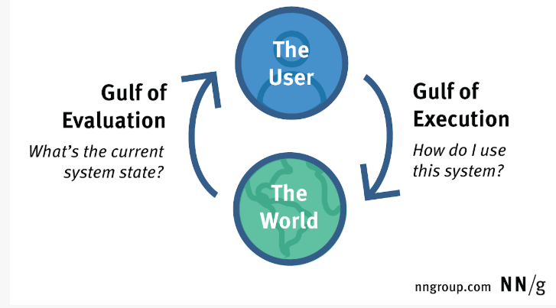
Gulf of Execution & Evaluation

Slide 41
Models of Interaction
“All models are wrong, but some are useful” - George Box
Norman’s Execution-Evaluation Cycle :
  Establishing the goal.
  Forming the intention.
  Specifying the action sequence.
  Executing the action.
  Perceiving the system state.
  Interpreting the system state.
  Evaluating the system state with respect to the goals and intentions
Revise the goal

Slide 42
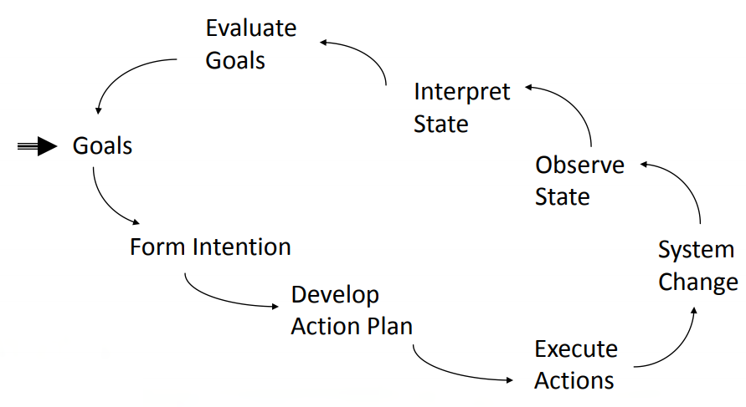
Norman’s Execution-Evaluation Cycle

Slide 43
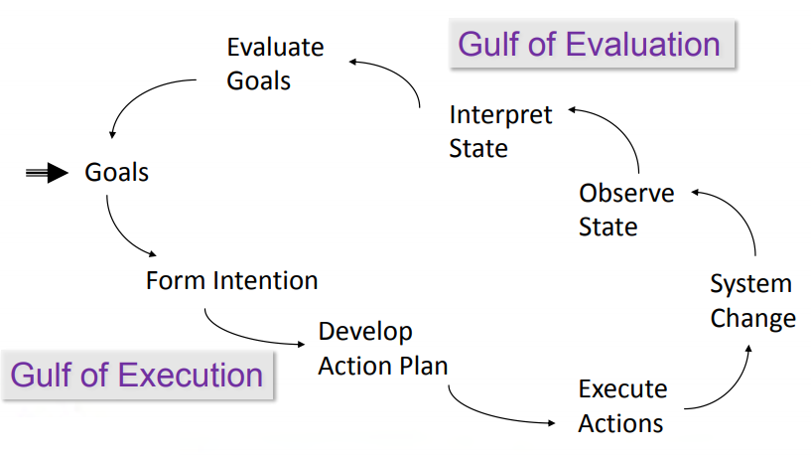
Norman’s Execution-Evaluation Cycle

Slide 44
Norman’s Execution-Evaluation Cycle

Slide 45
Bridging the Gap
Gulf of Execution: “How do I do it?”
  Commands and mechanisms need to match the goals, intension, and expectations of a person
Gulf of Evaluation: “What does it mean?”
  Output needs to present a view of the system that is readily perceived, interpreted, and evaluated

Slide 46
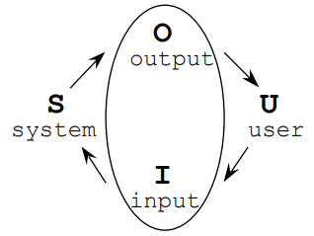
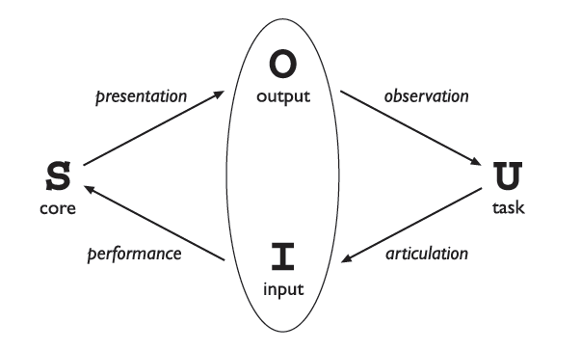
The Interaction Framework
The general interaction framework
Translations between components

Slide 47
Text entry devices
The most obvious means of text entry is the plain keyboard, but there are several variations on this: different keyboard layouts, ‘chord’ keyboards that use combinations of fingers to enter letters, and phone key pads. Handwriting and speech recognition offer more radical alternatives.
The alphanumeric keyboard The keyboard is still one of the most common input devices in use today. It is used for entering textual data and commands. The vast majority of keyboards have a standardized layout, and are known by the first six letters of the top row of alphabetical
keys, QWERTY.

Slide 48
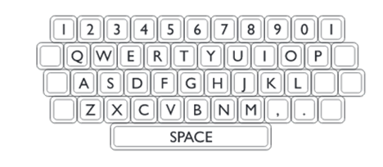
The QWERTY keyboard
The layout of the digits and letters on a QWERTY keyboard is fixed , but non-alphanumeric keys vary between keyboards.

Slide 49
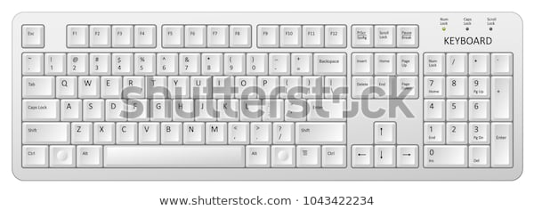
Alphabetic Layout

Slide 50
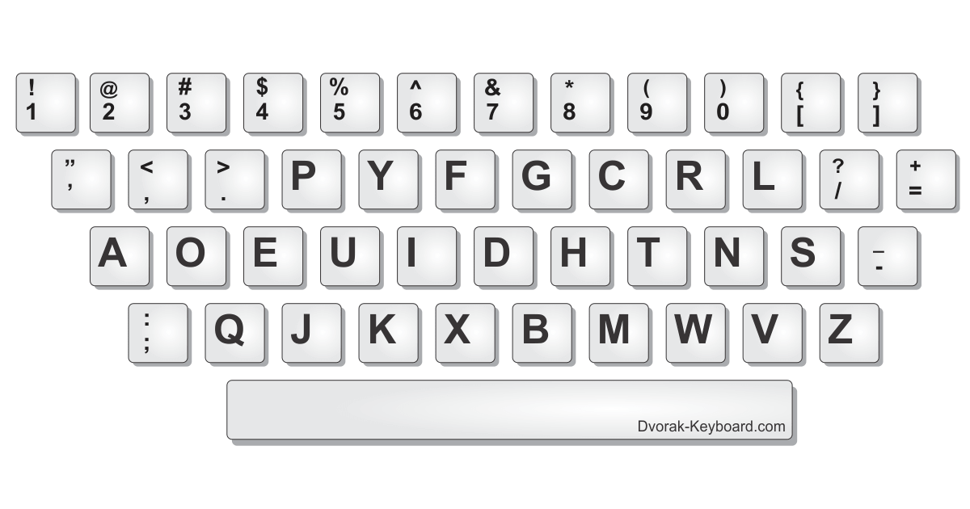
Dvorak Layout

Slide 51
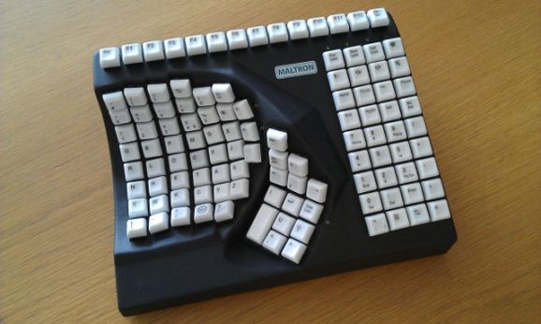
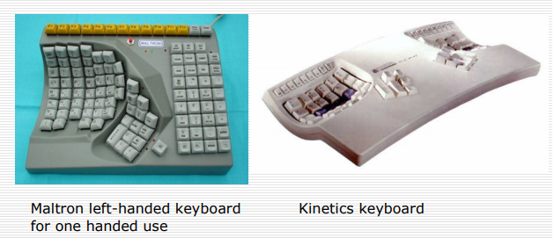
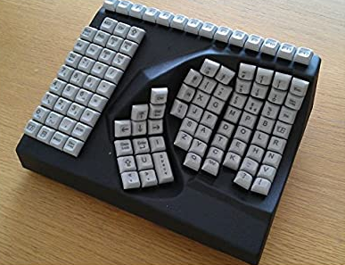
Special Keyboards

Slide 52
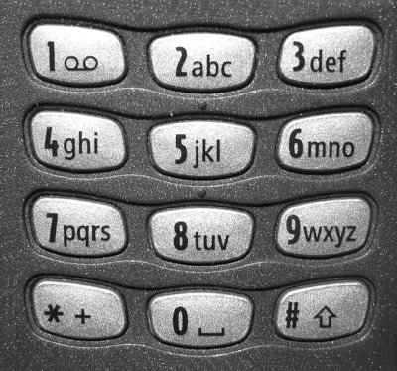
Phone pads

Slide 53
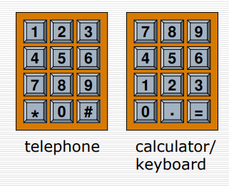
Numeric Keypad

Slide 54
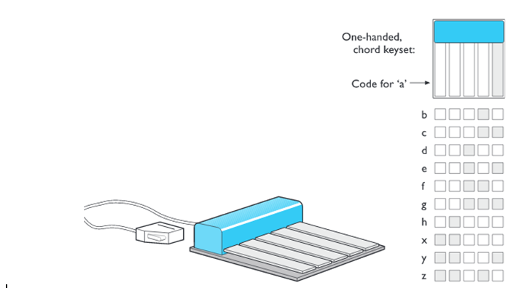
Chord keyboards
Chord keyboards are significantly different from normal alphanumeric keyboards

Slide 55
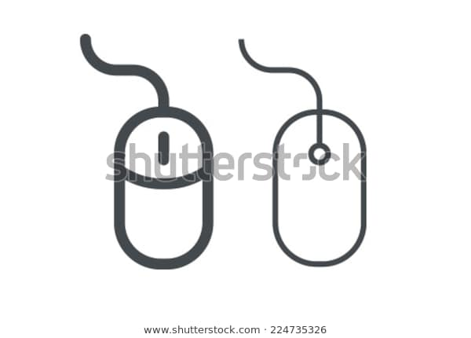
Positioning, pointing and drawing
The mouse
The mouse has become a major component of the majority of desktop computer systems sold today, and is the little box with the tail connecting it to the machine in our basic computer system picture .

Slide 56
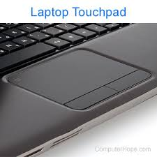
Touchpad
Touchpads are touch-sensitive tablets usually around 2–3 inches (50–75 mm) square. They were first used extensively in Apple Powerbook portable computers but are now used in many other notebook computers and can be obtained separately to replace the mouse on the desktop.

Slide 57
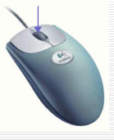
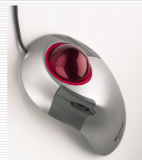
Trackball and thumbwheel
The trackball is really just an upside-down mouse! A weighted ball faces upwards and is rotated inside a static housing, the motion being detected in the same way as for a mechanical mouse, and the relative motion of the ball moves the cursor.

Slide 58
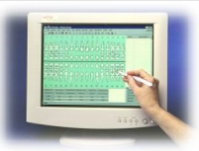
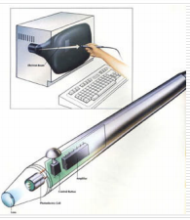
Stylus and light pen
For more accurate positioning (and to avoid greasy screens), systems with touch sensitive surfaces often emply a stylus. Instead of pointing at the screen directly a small pen-like plastic stick is used to point and draw on the screen. This is particularly popular in PDAs, but they are also being used in some laptop computers.

Slide 59
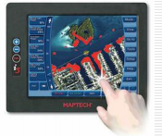
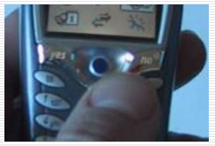
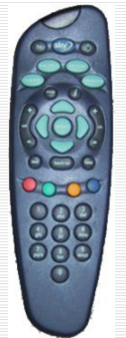
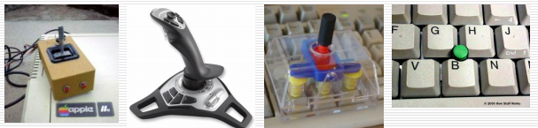
Touch sensitive screen
Display Positioning Control
Joystick and trackpoint

Slide 60
Display devices
Bitmap displays – resolution and color
Virtually all computer displays are based on some sort of bitmap. That is the display is made of vast numbers of colored dots or pixels in a rectangular grid. These pixels may be limited to black and white (for example, the small display on many TV remote controls), in grayscale, or full color.
There are two numbers to consider:
  The total number of pixels: in standard computer displays this is always in a 4:3 ratio, perhaps 1024 pixels across by 768 down, or 1600 ×1200; for PDAs this will be more in the order of a few hundred pixels in each direction.
  The density of pixels: this is measured in pixels per inch. Unlike printers this density varies little between 72 and 96 pixels per inch.
When using a single color jaggies are inevitable. Similar effects are seen in bitmap fonts.

Slide 61
Devices for virtual reality and 3D interaction
Positioning in 3D space
Virtual reality systems present a 3D virtual world. Users need to navigate through these spaces and manipulate the virtual objects they find there. Navigation is not simply a matter of moving to a particular location, but also of choosing a particular orientation. In addition, when you grab an object in real space, you don’t simply move it around, but also twist and turn it, for example when opening a door. Thus the move from mice to 3D devices usually involves a change from two degrees of freedom to six degrees of freedom, not just three.Cockpit and virtual controls
Helicopter and aircraft pilots already have to navigate in real space.

Slide 62
Devices for virtual reality and 3D interaction
The 3D mouse
There are a variety of devices that act as 3D versions of a mouse. Rather than just moving the mouse on a tabletop, you can pick it up, move it in three dimensions, rotate the mouse and tip it forward and backward. The 3D mouse has a full six degrees of freedom as its position can be tracked (three degrees), and also its up/down angle (called pitch), its left/right orientation (called yaw) and the amount it is twisted about its own axis (called roll)

Slide 63
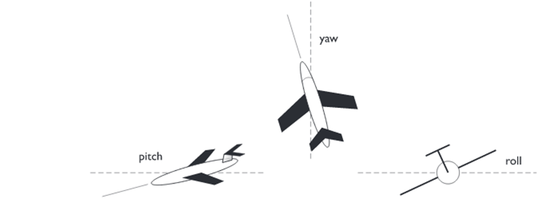
Pitch, Yaw and Roll

Slide 64
3D Displays
Seeing in 3D
  Our eyes use many cues to perceive depth in the real world .It is in fact quite remarkable as each eye sees only a flattened form of the world, like a photograph. One important effect is stereoscopic vision (or simply stereo vision). The ideal would be to be able to look at a special 3D screen and see 3D images just as one does with a hologram – 3D television just like in all the best sci-fi movies.
VR motion sickness
  In real life when we move our head the image our eyes see changes accordingly. VR systems produce the same effect by using sensors in the goggles or helmet and then using the position of the head to determine the right image to show.
Simulators and VR caves
  Because of the problems of delivering a full 3D environment via head-mounted displays, some virtual reality systems work by putting the user within an environment where the virtual world is displayed upon it.

Slide 65
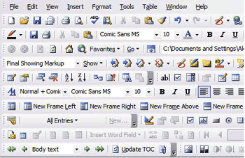
Physical controls, sensors and special devices
The WIMP interface
  Currently many common environments for interactive computing are examples of the WIMP interface style, often simply called windowing systems. WIMP stands for windows, icons, menus and pointers (sometimes windows, icons, mice and pull-down menus), and is the default interface style for the majority of interactive computer systems in use today, especially in the PC and desktop workstation arena.

Slide 66
Paper: printing and scanning
Paper:Printing and Scanning
The most common types of dot-based printers are dot-matrix printers, ink-jet printers and laser printers.
These are listed roughly in order of increasing resolution and quality, where dot-matrix printers typically have a resolution of 80–120 dpi rising to about 300–600 dpi for ink-jet printers and 600–2400 dpi for laser printers.
By varying the quantity of ink and quality of paper, ink-jet printers can be used to print photo-quality prints from digital photographs

Slide 67
Interaction styles
Interaction can be seen as a dialog between the computer and the user. The choice of interface style can have a profound effect on the nature of this dialog.
There are a number of common interface styles including
  command line interface
  menus
  natural language
  question/answer and query dialog
  form-fills and spreadsheets
  WIMP
  point and click
  three-dimensional interfaces.

Slide 68
Hints:
Batch processing is a method of processing data where a group of transactions is collected over a period of time and processed all at once.
Some examples of batch processing include payroll processing, billing systems, end-of-day reports in banking, and processing of credit card transactions. back

